Slide 1
IT 356: Introduction To Computer Graphics (Lecture 17)
School of Information Technology
Illinois State University
Dr. Qi Zhang, Spring 2024

Slide 2
Coordinate Systems

Slide 3
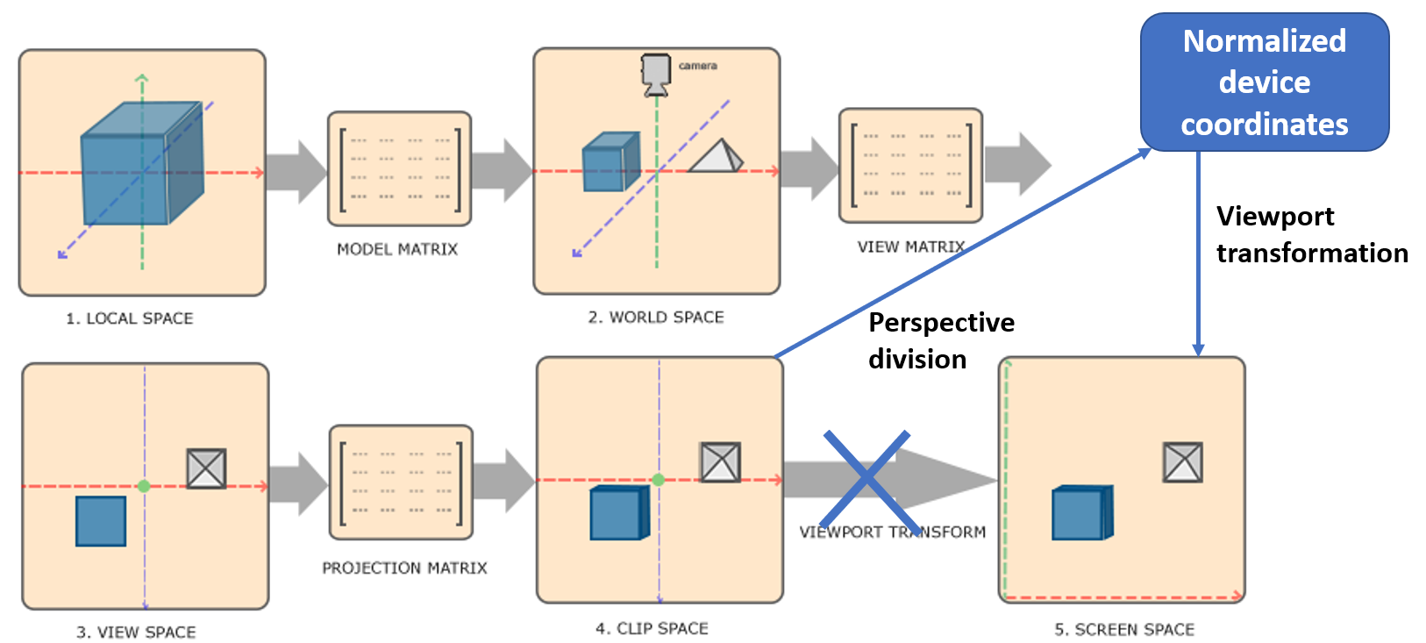
Putting It All Together
We create a transformation matrix for each of the transformation steps: model, view and projection matrix.
A vertex coordinate is then transformed to clip coordinates as follows
Note: the projection matrix transforms vertex coordinates to clip space, then OpenGL will automatically clip coordinates and then transform them to NDC space using perspective division

Slide 4
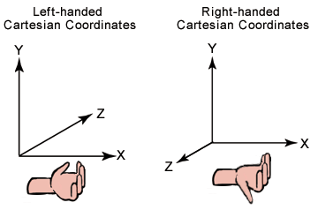
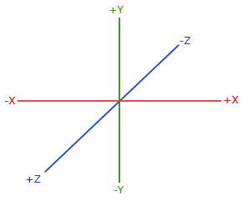
Right-Handed System
By convention, OpenGL is a right-handed system.
What this says is that the positive x-axis is to your right, the positive y-axis is up, and the positive z-axis is backward.
Think of your screen being the center of the three axes and the positive z-axis going through your screen towards you.

Slide 5
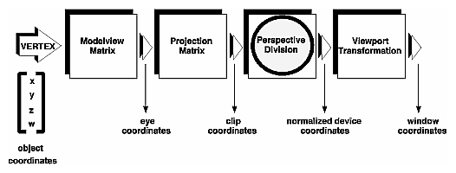
Putting It All Together
Note that the order of matrix multiplication is reversed (remember that we need to read matrix multiplication from right to left).
The resulting vertex should then be assigned to gl_Position in the vertex shader, and OpenGL will then automatically perform perspective division and clipping.
The vertex shader output requires the coordinates to be in clip space, which we did with the transformation matrices.

Slide 6
Viewport Transform
OpenGL then performs perspective division on the clip-space coordinates to transform them to normalized-device coordinates.
OpenGL then uses the parameters from glViewPort to map the normalized device coordinates (coordinates after clipping and perspective division) to screen/window coordinates, where each coordinate corresponds to a point on your screen. This process is called the viewport transform.

Slide 7
Going 3D
Now that we know how to transform 3D coordinates to 2D coordinates, we can start showing our objects as real 3D objects instead of a 2D plane we've been showing so far.
To start drawing in 3D, we'll first create a model matrix.
The model matrix consists of translations, scaling and/or rotations we'd like to apply to transform all object's vertices to the global world space

Slide 8
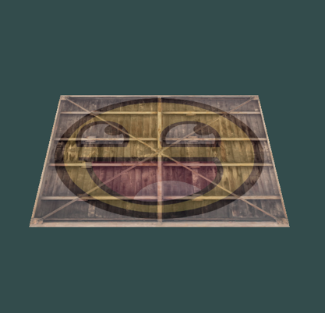
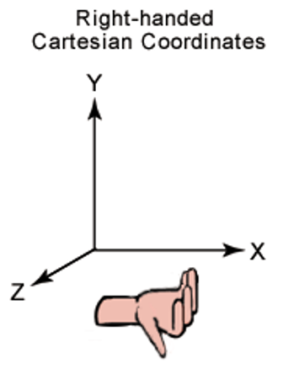
Model Matrix
Let's transform our plane a bit by rotating it on the x-axis, so it looks like it's laying on the floor. The model matrix:
By multiplying the vertex coordinates with this model matrix, we're transforming the vertex coordinates to world coordinates.
Our plane that is slightly on the floor, thus represents the plane in the global world.

Slide 9
View Matrix
Next, we need to create a view matrix.
We want to move slightly backwards in the scene, so the object becomes visible (when in world space, we're located at the origin (0,0,0)).
To move around the scene, think about the following:
To move a camera backwards, is the same as moving the entire scene forward.

Slide 10
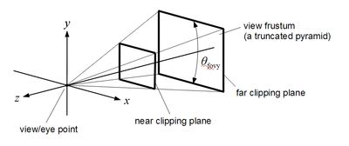
View Matrix
That is exactly what a view matrix does. We move the entire scene inverted to where we want the camera to move.
Because we want to move backward, and since OpenGL is a right-handed system, we must move in the positive z-axis.
We do this by translating the scene towards the negative z-axis. This gives the impression that we are moving backward.

Slide 11
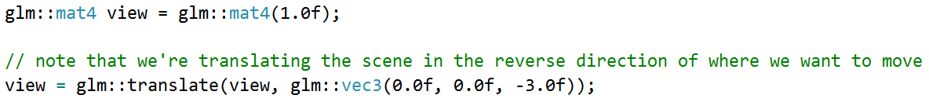
View Matrix
For now, the view matrix looks like this:
The last thing we need to define is the projection matrix. We want to use perspective projection for our scene, so we'll declare the projection matrix like this:
Then OpenGL will automatically clip coordinates and transform them to NDC space using perspective division

Slide 12
Example 1
Declare VBO, VAO, EBO, Shader Program ID, and Two textures
//Vertex Buffer Object (VBO)
unsigned int VBO;
//Vertex Array Object (VAO)
unsigned int VAO;
//Element Buffer Objects
unsigned int EBO;
//Shader Program (shaderProgram)'s ID
unsigned int shaderProgram;
//Two textures
unsigned int texture1, texture2;

Slide 13
Initialize shaderProgram
//Return shaderProgram, which is used to set the shader program's ID
shaderProgram = loadShader("../../src/shader/texture1.vert", "../../src/shader/texture1.frag");

Slide 14
Set up Vertex Data
//Set up vertex data (and buffer(s)) and configure vertex attributes
float vertices[] = {
//positions //textures
0.5f, 0.5f, 0.0f, 1.0f, 1.0f, // top right
0.5f, -0.5f, 0.0f, 1.0f, 0.0f, // bottom right
-0.5f, -0.5f, 0.0f, 0.0f, 0.0f, // bottom left
-0.5f, 0.5f, 0.0f, 0.0f, 1.0f // top left
};
unsigned int indices[] = {
0, 1, 3, // first triangle
1, 2, 3 // second triangle
};

Slide 15
Generate VAO, VOB, and EBO
//Generate VAO, VBO, and EBO
glGenVertexArrays(1, &VAO);
glGenBuffers(1, &VBO);
glGenBuffers(1, &EBO);

Slide 16
Bind VAO, VBO, and EBO to Array Buffer
//Bind VAO, VBO, and EBO to array buffer
//Create and initialize a buffer object's data store for VBO and EBO
//by loading vertices and indices to graphics memory
glBindVertexArray(VAO);
glBindBuffer(GL_ARRAY_BUFFER, VBO);
glBufferData(GL_ARRAY_BUFFER, sizeof(vertices), vertices, GL_STATIC_DRAW);
glBindBuffer(GL_ELEMENT_ARRAY_BUFFER, EBO);
glBufferData(GL_ELEMENT_ARRAY_BUFFER, sizeof(indices), indices, GL_STATIC_DRAW);

Slide 17
Arrange Data in Graphics Memory
//Arrange data in graphics memory using attribute pointer
//Position attribute
glVertexAttribPointer(0, 3, GL_FLOAT, GL_FALSE, 5 * sizeof(float), (void*)0);
glEnableVertexAttribArray(0);
//Texture coord attribute
glVertexAttribPointer(1, 2, GL_FLOAT, GL_FALSE, 5 * sizeof(float), (void*)(3 * sizeof(float)));
glEnableVertexAttribArray(1);

Slide 18
Load and Create Texture 1
//Load and create the texture 1
glGenTextures(1, &texture1);
glBindTexture(GL_TEXTURE_2D, texture1);
//set the texture wrapping parameters
glTexParameteri(GL_TEXTURE_2D, GL_TEXTURE_WRAP_S, GL_REPEAT);
//set texture wrapping to GL_REPEAT (default wrapping method)
glTexParameteri(GL_TEXTURE_2D, GL_TEXTURE_WRAP_T, GL_REPEAT);
//set texture filtering parameters
glTexParameteri(GL_TEXTURE_2D, GL_TEXTURE_MIN_FILTER, GL_LINEAR);
glTexParameteri(GL_TEXTURE_2D, GL_TEXTURE_MAG_FILTER, GL_LINEAR);

Slide 19
Load Image and Create Texture
//load image, create texture, and generate mipmaps
int width, height, nrChannels;
//tell stb_image.h to flip loaded textures on the y-axis.
stbi_set_flip_vertically_on_load(true);
unsigned char *data = stbi_load("../../src/resources/textures/container.jpg",
&width, &height, &nrChannels, 0);
generateTexture2D(data, width, height, nrChannels);

Slide 20
Load and Create Texture 2
//Load and create the texture 2
glGenTextures(1, &texture2);
glBindTexture(GL_TEXTURE_2D, texture2);
//set the texture wrapping parameters
//set texture wrapping to GL_REPEAT (default wrapping method)
glTexParameteri(GL_TEXTURE_2D, GL_TEXTURE_WRAP_S, GL_REPEAT);
glTexParameteri(GL_TEXTURE_2D, GL_TEXTURE_WRAP_T, GL_REPEAT);
//set texture filtering parameters
glTexParameteri(GL_TEXTURE_2D, GL_TEXTURE_MIN_FILTER, GL_LINEAR);
glTexParameteri(GL_TEXTURE_2D, GL_TEXTURE_MAG_FILTER, GL_LINEAR);

Slide 21
Load Image and Create Texture
//load image, create texture, and generate mipmaps
data = stbi_load("../../src/resources/textures/awesomeface.png", &width, &height, &nrChannels, 0);
generateTexture2D(data, width, height, nrChannels);

Slide 22
Transfer Texture 1 and 2 to Fragment Shader
//Transfer texture1 and texture2 to fragment shader
//Tell OpenGL for each sampler to which texture unit it belongs to
//(only has to be done once)
glUseProgram(shaderProgram);
glUniform1i(glGetUniformLocation(shaderProgram, "texture1"), 0);
glUniform1i(glGetUniformLocation(shaderProgram, "texture2"), 1);

Slide 23
Bind Textures to Texture Units
//Bind textures on corresponding texture units
//Activate the texture unit first before binding the texture
glActiveTexture(GL_TEXTURE0);
glBindTexture(GL_TEXTURE_2D, texture1);
glActiveTexture(GL_TEXTURE1);
glBindTexture(GL_TEXTURE_2D, texture2);

Slide 24
Activate Shader
//Activate shader
glUseProgram(shaderProgram);

Slide 25
Create Transformations
Initialize matrix to identity matrix first
//Create transformations
//make sure to initialize matrix to identity matrix first
glm::mat4 model = glm::mat4(1.0f);
glm::mat4 view = glm::mat4(1.0f);
glm::mat4 projection = glm::mat4(1.0f);
//Add model matrix
model = glm::rotate(model, glm::radians(-55.0f), glm::vec3(1.0f, 0.0f, 0.0f));
//Add view matrix
view = glm::translate(view, glm::vec3(0.0f, 0.0f, -3.0f));
//Add perspective matrix
projection = glm::perspective(glm::radians(45.0f), (float)SCR_WIDTH / (float)SCR_HEIGHT, 0.1f, 100.0f);

Slide 26
Retrieve the Matrix Uniform Locations
//Retrieve the matrix uniform locations
//glUniformMatrix4fv()
unsigned int modelLoc = glGetUniformLocation(shaderProgram, "model");
unsigned int viewLoc = glGetUniformLocation(shaderProgram, "view");
unsigned int projectLoc = glGetUniformLocation(shaderProgram, "projection");

Slide 27
Pass Matrices to Shaders
//Pass them to the shaders (2 different ways)
glUniformMatrix4fv(modelLoc, 1, GL_FALSE, glm::value_ptr(model));
glUniformMatrix4fv(viewLoc, 1, GL_FALSE, glm::value_ptr(view));
glUniformMatrix4fv(projectLoc, 1, GL_FALSE, glm::value_ptr(projection));

Slide 28
Vertex Shader: texture1.vert
#version 460 core
layout (location = 0) in vec3 aPos;
layout (location = 1) in vec2 aTexCoord;
out vec2 TexCoord;
uniform mat4 model;
uniform mat4 view;
uniform mat4 projection;
void main()
{
gl_Position = projection * view * model * vec4(aPos, 1.0);
TexCoord = vec2(aTexCoord.x, aTexCoord.y);
}

Slide 29
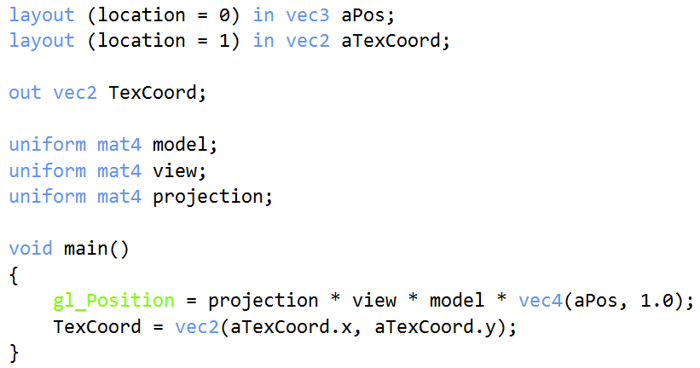
Matrices in Vertex Shader
Now that we created the transformation matrices, we should pass them to our shaders.
First, let's declare the transformation matrices as uniforms in the vertex shader and multiply them with the vertex coordinates:

Slide 30
Fragment Shader: texture1.frag
#version 460 core
out vec4 FragColor;
in vec2 TexCoord;
// texture samplers
uniform sampler2D texture1;
uniform sampler2D texture2;
void main()
{
// linearly interpolate between both textures (80% container, 20% awesomeface)
FragColor = mix(texture(texture1, TexCoord), texture(texture2, TexCoord), 0.2);
}

Slide 31
Render Container
//Render container
glBindVertexArray(VAO);
glDrawElements(GL_TRIANGLES, 6, GL_UNSIGNED_INT, 0);

Slide 32
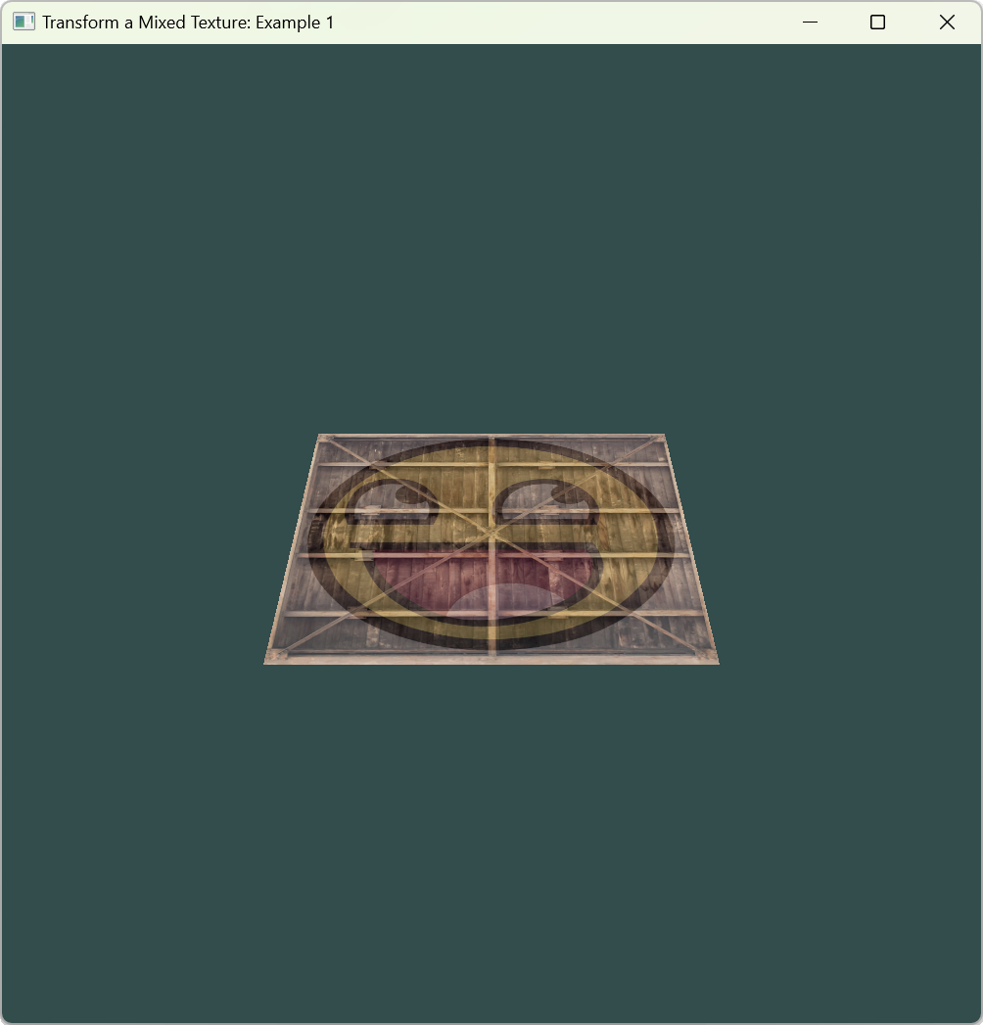
Release Resources
//Optional: de-allocate all resources once they've outlived their purpose:
glDeleteVertexArrays(1, &VAO);
glDeleteBuffers(1, &VBO);
glDeleteBuffers(1, &EBO);

Slide 33
Update Set Up Vertex Data
//set up vertex data (and buffer(s)) and configure vertex attributes
float vertices[] = {
-0.5f, -0.5f, -0.5f, 0.0f, 0.0f,
0.5f, -0.5f, -0.5f, 1.0f, 0.0f,
0.5f, 0.5f, -0.5f, 1.0f, 1.0f,
0.5f, 0.5f, -0.5f, 1.0f, 1.0f,
-0.5f, 0.5f, -0.5f, 0.0f, 1.0f,
-0.5f, -0.5f, -0.5f, 0.0f, 0.0f,
-0.5f, -0.5f, 0.5f, 0.0f, 0.0f,
0.5f, -0.5f, 0.5f, 1.0f, 0.0f,
0.5f, 0.5f, 0.5f, 1.0f, 1.0f,
0.5f, 0.5f, 0.5f, 1.0f, 1.0f,
-0.5f, 0.5f, 0.5f, 0.0f, 1.0f,
-0.5f, -0.5f, 0.5f, 0.0f, 0.0f,
-0.5f, 0.5f, 0.5f, 1.0f, 0.0f,
-0.5f, 0.5f, -0.5f, 1.0f, 1.0f,
-0.5f, -0.5f, -0.5f, 0.0f, 1.0f,
-0.5f, -0.5f, -0.5f, 0.0f, 1.0f,
-0.5f, -0.5f, 0.5f, 0.0f, 0.0f,
-0.5f, 0.5f, 0.5f, 1.0f, 0.0f,
0.5f, 0.5f, 0.5f, 1.0f, 0.0f,
0.5f, 0.5f, -0.5f, 1.0f, 1.0f,
0.5f, -0.5f, -0.5f, 0.0f, 1.0f,
0.5f, -0.5f, -0.5f, 0.0f, 1.0f,
0.5f, -0.5f, 0.5f, 0.0f, 0.0f,
0.5f, 0.5f, 0.5f, 1.0f, 0.0f,
-0.5f, -0.5f, -0.5f, 0.0f, 1.0f,
0.5f, -0.5f, -0.5f, 1.0f, 1.0f,
0.5f, -0.5f, 0.5f, 1.0f, 0.0f,
0.5f, -0.5f, 0.5f, 1.0f, 0.0f,
-0.5f, -0.5f, 0.5f, 0.0f, 0.0f,
-0.5f, -0.5f, -0.5f, 0.0f, 1.0f,
-0.5f, 0.5f, -0.5f, 0.0f, 1.0f,
0.5f, 0.5f, -0.5f, 1.0f, 1.0f,
0.5f, 0.5f, 0.5f, 1.0f, 0.0f,
0.5f, 0.5f, 0.5f, 1.0f, 0.0f,
-0.5f, 0.5f, 0.5f, 0.0f, 0.0f,
-0.5f, 0.5f, -0.5f, 0.0f, 1.0f
};
So far, we've been working with a 2D plane, even in 3D space, so let's take the adventurous route and extend our 2D plane to a 3D cube.
To render a cube, we need 36 vertices (6 faces * 2 triangles * 3 vertices each).

Slide 34
Delete Bind EBO
//glBindBuffer(GL_ELEMENT_ARRAY_BUFFER, EBO);
//glBufferData(GL_ELEMENT_ARRAY_BUFFER, sizeof(indices), indices, GL_STATIC_DRAW);

Slide 35
Update Render Container
////Render container
//glBindVertexArray(VAO);
//glDrawElements(GL_TRIANGLES, 6, GL_UNSIGNED_INT, 0);
//Render container
glBindVertexArray(VAO);
glDrawArrays(GL_TRIANGLES, 0, 36);

Slide 36
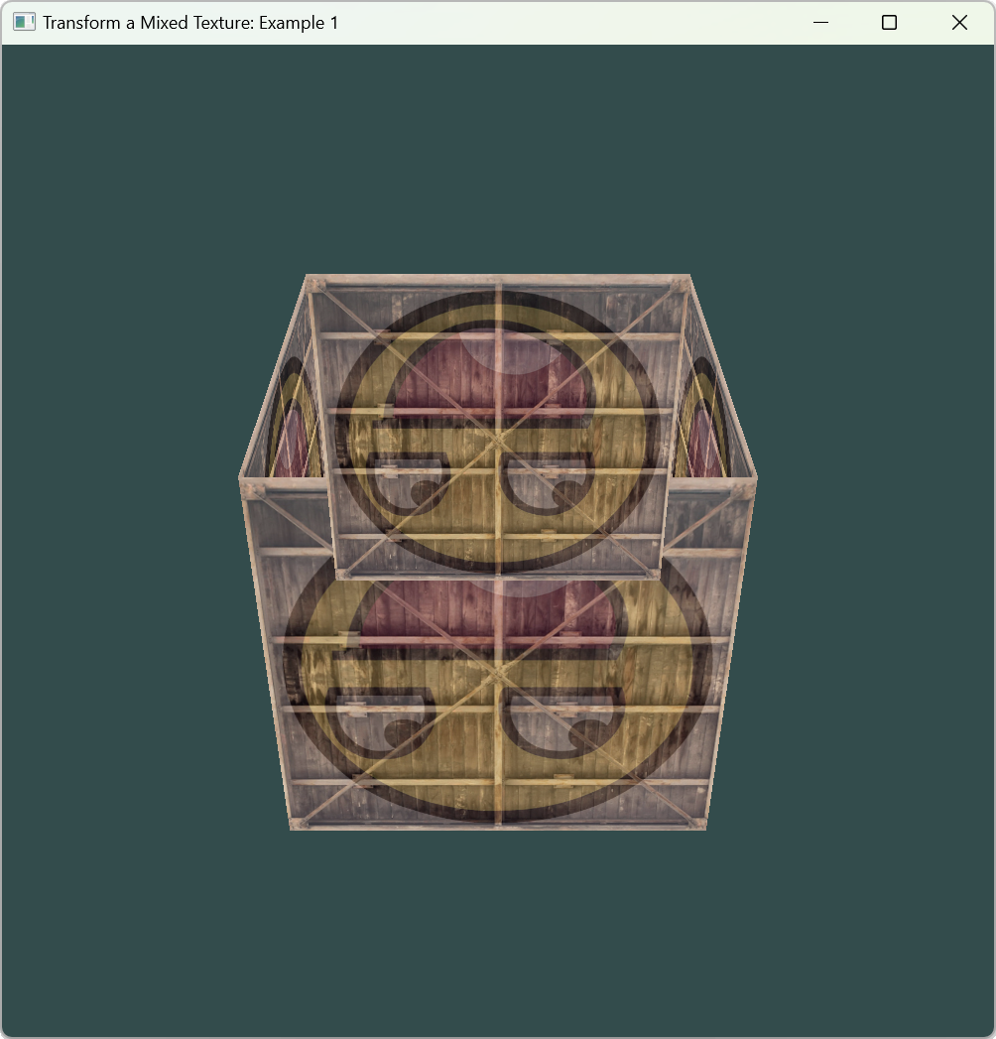
Running Result

Slide 37
Update Add Model View and Project Matrices
// Add model view and project matrices
model = glm::rotate(model, (float)glfwGetTime(), glm::vec3(0.5f, 1.0f, 0.0f));
view = glm::translate(view, glm::vec3(0.0f, 0.0f, -3.0f));
projection =
glm::perspective(glm::radians(45.0f), (float)SCR_WIDTH / (float)SCR_HEIGHT, 0.1f, 100.f);

Slide 38
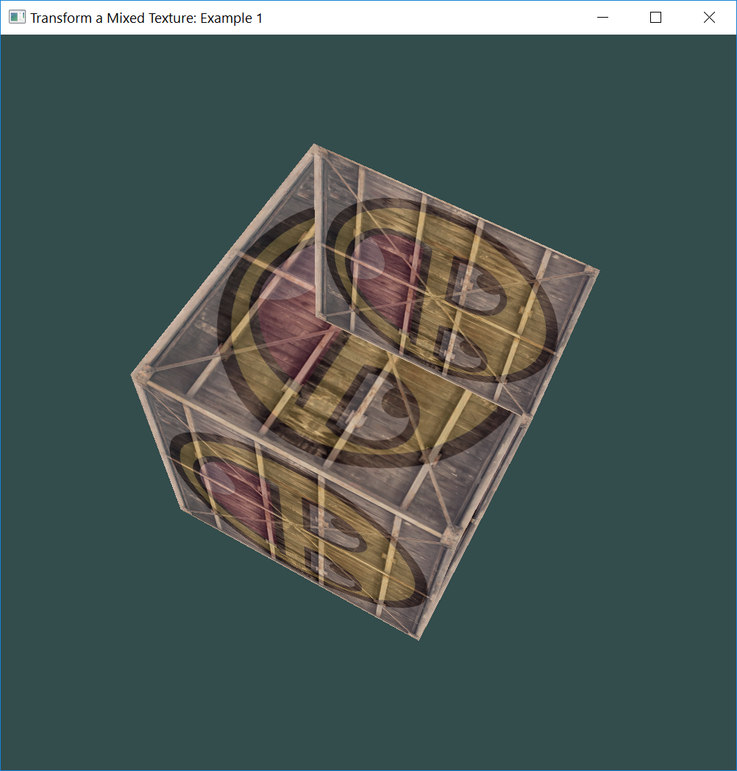
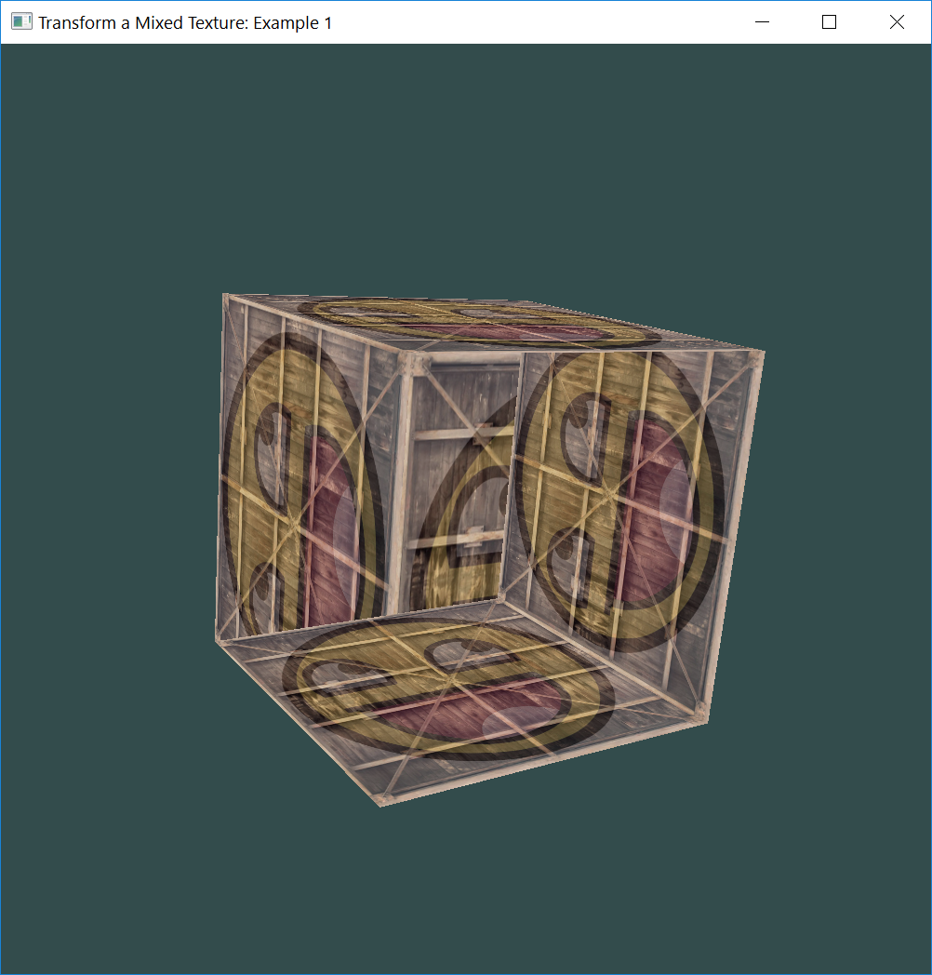
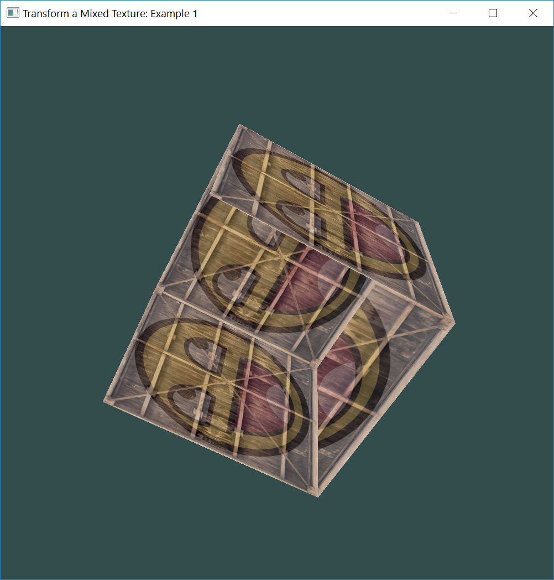
Artifacts
It does resemble a cube slightly, but something's off. Some sides of the cubes are being drawn over other sides of the cube.
This happens because when OpenGL draws the cube triangle-by-triangle, it will overwrite its pixels even though something else might've been drawn there before.
Because of this, some triangles are drawn on top of each other while they're not supposed to overlap.

Slide 39
Z-buffer
OpenGL stores all its depth information in a z-buffer, also known as a depth buffer.
GLFW automatically creates such a buffer for you (just like it has a color-buffer that stores the colors of the output image).

Slide 40
Depth Testing
The depth is stored within each fragment (as the fragment's z value)
Whenever the fragment wants to output its color, OpenGL compares its depth values with the z-buffer
If the current fragment is behind the other fragment, it is discarded, otherwise overwritten.
This process is called depth testing and is done automatically by OpenGL.

Slide 41
Enable Depth Test Inside init(void) Function
If we want to make sure OpenGL actually performs the depth testing, we first need to tell OpenGL we want to enable depth testing
Depth testing is disabled by default. We can enable depth testing using glEnable.
The glEnable and glDisable functions allow us to enable/disable certain functionality in OpenGL.
//configure global OpenGL state
//Enable depth test
glEnable(GL_DEPTH_TEST);

Slide 42
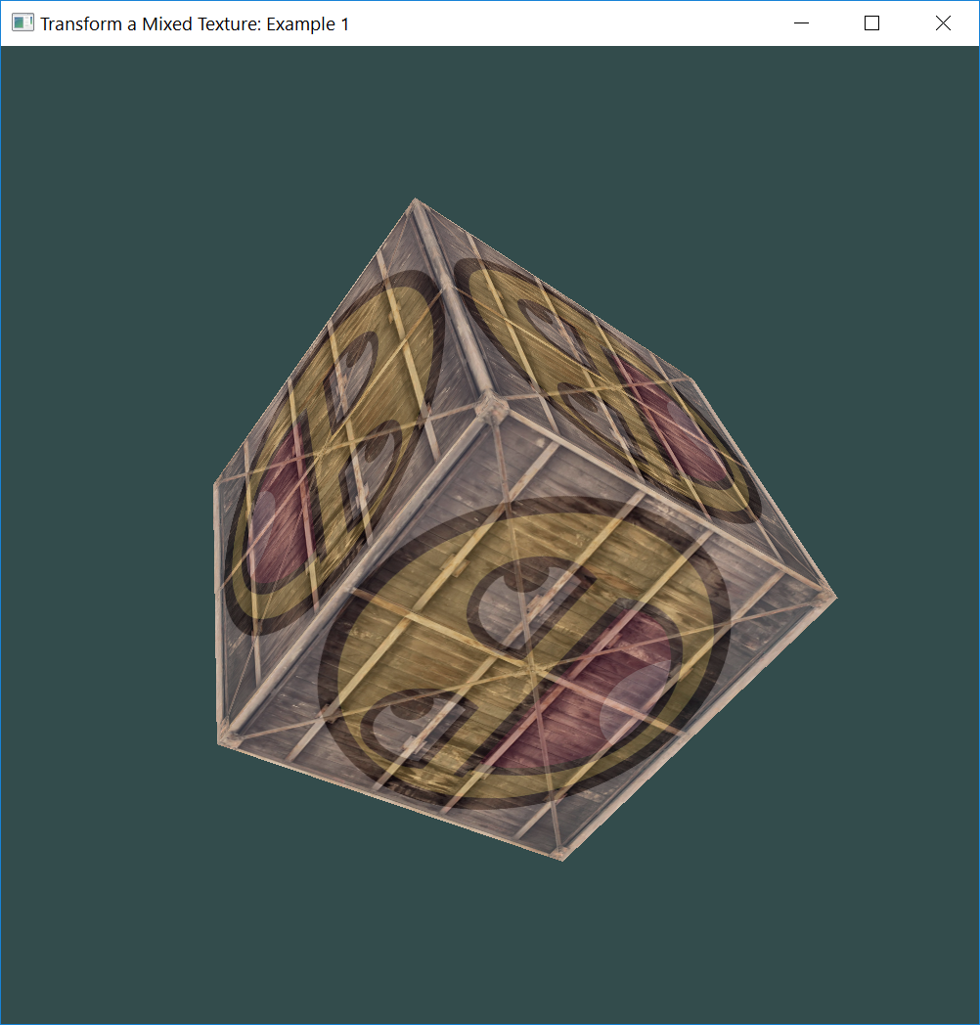
Clear Depth Buffer
Since we're using a depth buffer, we also want to clear the depth buffer before each render iteration (otherwise, the depth information of the previous frame stays in the buffer).
Just like clearing the color buffer, we can clear the depth buffer by specifying the DEPTH_BUFFER_BIT bit in the glClear function:

Slide 43
Update Clear Buffers
//Clear Buffers
////Render
//glClearColor(0.2f, 0.3f, 0.3f, 1.0f);
//glClear(GL_COLOR_BUFFER_BIT);
//Render
glClearColor(0.2f, 0.3f, 0.3f, 1.0f);
// also clear the depth buffer now!
glClear(GL_COLOR_BUFFER_BIT | GL_DEPTH_BUFFER_BIT);

Slide 44
More Cubes
We wanted to display 10 of our cubes on screen.
Each cube will look the same but will only differ in where it's located in the world with each a different rotation.
The graphical layout of the cube is already defined so we don't have to change our buffers or attribute arrays when rendering more objects.
The only thing we have to change for each object is its model matrix where we transform the cubes into the world.

Slide 45
More Cubes
Define a translation vector for each cube that specifies its position in world space.
We'll define 10 cube positions in a glm::vec3 array:

Slide 46
Ten Cube Positions
//Ten cube positions
glm::vec3 cubePositions[10];
//World space positions of our cubes
cubePositions[0] = glm::vec3(0.0f, 0.0f, 0.0f);
cubePositions[1] = glm::vec3(2.0f, 5.0f, -15.0f);
cubePositions[2] = glm::vec3(-1.5f, -2.2f, -2.5f);
cubePositions[3] = glm::vec3(-3.8f, -2.0f, -12.3f);
cubePositions[4] = glm::vec3(2.4f, -0.4f, -3.5f);
cubePositions[5] = glm::vec3(-1.7f, 3.0f, -7.5f);
cubePositions[6] = glm::vec3(1.3f, -2.0f, -2.5f);
cubePositions[7] = glm::vec3(1.5f, 2.0f, -2.5f);
cubePositions[8] = glm::vec3(1.5f, 0.2f, -1.5f);
cubePositions[9] = glm::vec3(-1.3f, 1.0f, -1.5f);

Slide 47
Update Render Boxes
//Render boxes
glBindVertexArray(VAO);
for (unsigned int i = 0; i < 10; i++)
{
//Calculate the model matrix for each object and pass it to the shader before drawing
glm::mat4 model = glm::mat4(1.0f);
model = glm::translate(model, cubePositions[i]);
float angle = 20.0f * i;
model = glm::rotate(model, glm::radians(angle), glm::vec3(1.0f, 0.3f, 0.5f));
unsigned int modelLoc = glGetUniformLocation(shaderProgram, "model");
glUniformMatrix4fv(modelLoc, 1, GL_FALSE, glm::value_ptr(model));
glDrawArrays(GL_TRIANGLES, 0, 36);
}

Slide 48
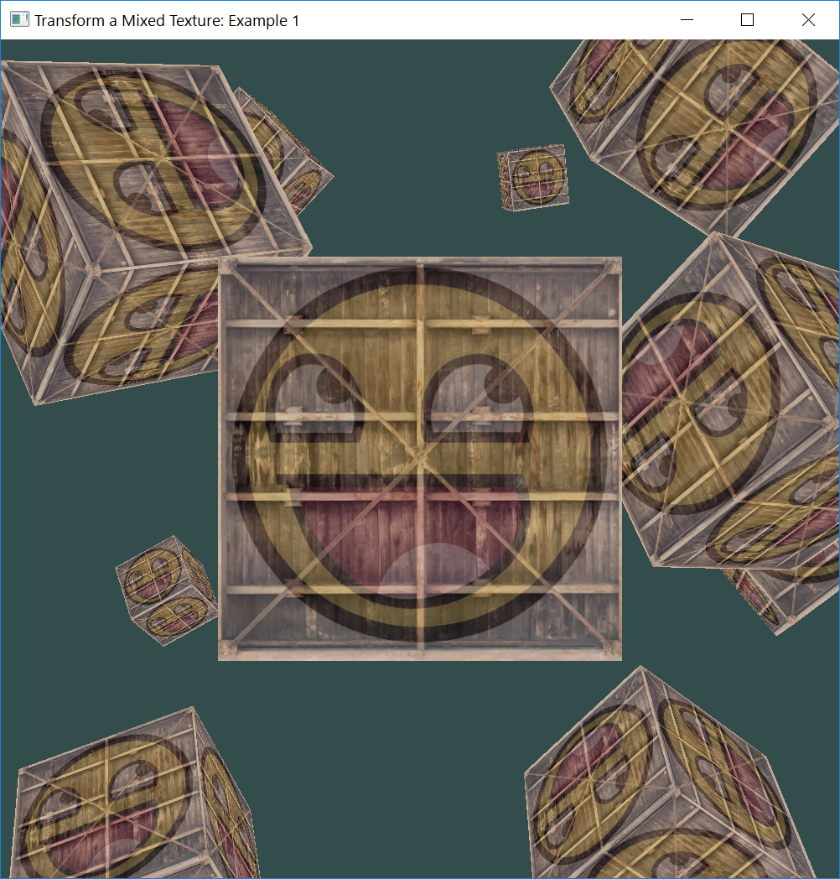
More Cubes
Now, within the game loop we want to call the glDrawArrays function 10 times, but this time send a different model matrix to the vertex shader each time before we render.
Create a small loop within the game loop that renders our object 10 times with a different model matrix. Also add a small rotation to each container.

Slide 49
Exercise
Try to make the first, fourth, seventh, and tenth containers rotate over time while leaving the other containers static.

